Slide 1
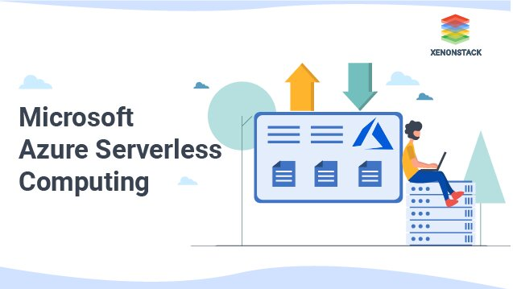
Azure Serverless

Slide 2
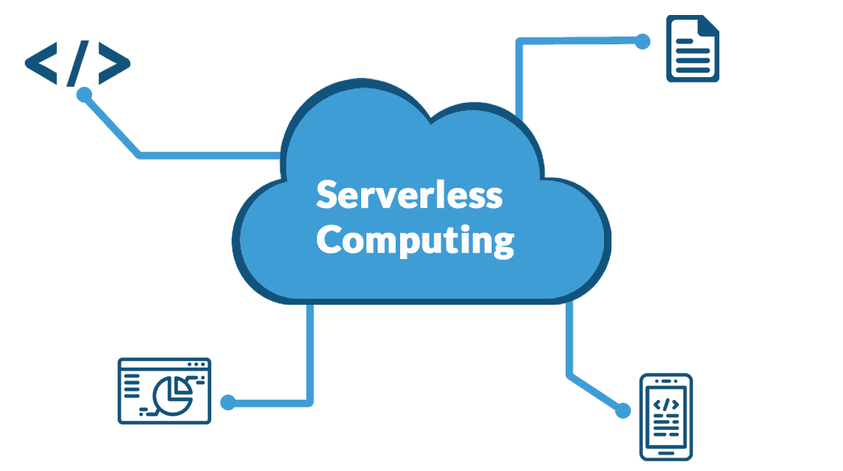
Intro to Azure Serverless
Azure Serverless refers to a cloud computing model where the cloud provider dynamically manages the allocation and provisioning of servers. Azure Serverless offerings, such as Azure Functions and Logic Apps, allow developers to focus solely on writing code or workflows without worrying about the infrastructure required to run and scale their applications. This model scales automatically based on demand, ensuring cost-efficiency by charging only for the resources consumed during execution. It's ideal for event-driven scenarios, microservices architectures, and applications with unpredictable traffic patterns.

Slide 3
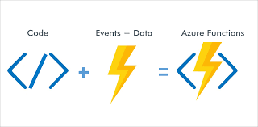
Azure Serverless Function
Azure Serverless Functions, also known as Azure Functions, are snippets of code that automatically run in response to events like HTTP requests or changes in data. They scale as needed and you only pay for the time they run, making them efficient for various applications without worrying about server management.

Slide 4
Key features
Event-driven: Functions are triggered by events such as HTTP requests, messages in queues, changes in storage, timer-based schedules, or external webhooks.
Pay-per-use: You are charged only for the time your function runs, scaling automatically based on demand. There's no charge when your function is idle.
Scalability: Azure Functions can scale automatically, handling thousands of simultaneous events.

Slide 5
Key features
Integration: Built-in integrations with other Azure services like Azure Storage, Azure Cosmos DB, Azure Service Bus, etc., enable seamless development of serverless applications.
Language support: Supports multiple programming languages including C#, JavaScript (Node.js), Python, PowerShell, and more, allowing developers to choose the language they are most comfortable with.
Monitoring and logging: Integrated monitoring and logging through Azure Application Insights provide insights into the performance and usage of your functions.

Slide 6
